Slide 1
BTC Software Programs – Update
Presented
By
FRA
[PSC]
01/21/2025

Slide 2
Agenda
Primary Test Structure & Process
Consolidated Report Overview
Next Steps
Notes:
The reason why I will explain in detail the primary data analysis process is to convey that although most of the process is automated, the process is still very involved for test engineers. This show that the data is validated and reviewed before building the report.

Slide 3
Primary Test Process Overview
Task Received
Acquire Cells
Enter Cell Information
Input detailed cell data into the inventory database
Test cells
Notes:
Task Received
Gather all requirements for the test
Acquire Cells
Purchase cells if they are not already available
Enter Cell Information
Input detailed cell data into the inventory database

Slide 4
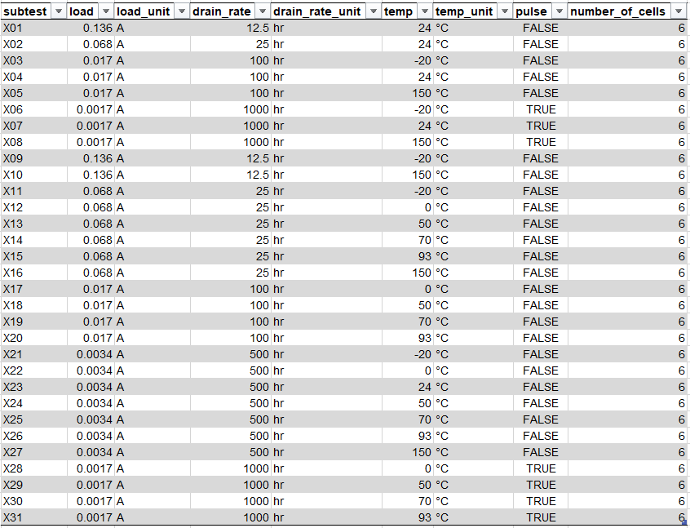
Primary Test Matrix

Slide 5
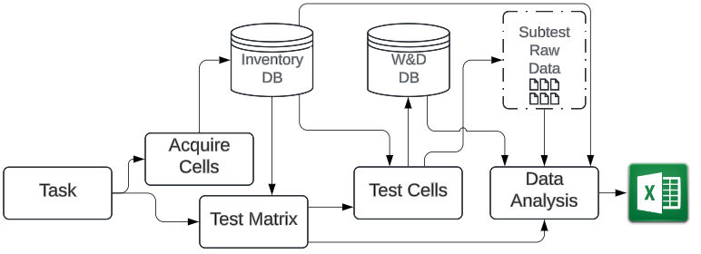
Primary Subtest Process Overview

Slide 6
Subtest Data Analysis
Software analyses every cell in the subtest.
Report test metrics at each voltage cutoff
Creates tables such as Voltage drops, Test voltages and DCIR, Weight and Dimensions tables
Generates Standard data visualizations in excel including VvC, VvE and TvC
Weight and dimensions for each excel is queried from the WD SQL Database
Test engineer
Handles test discrepancies
Validates data
Performs further data analysis if needed

Slide 7
Subtest Excel File
Allows python to easily extract tables
Allows test engineer to perform data validation and data analysis and correct any errors easily
Median cell is chosen by median capacity at principal voltage cutoff
Subtest excel file is used as data storage and python as the engine to process the data
This files is reviewed by an additional two test engineers

Slide 8
Building a Consolidated Excel File
The median cell data is extracted from each subtest along with all the other tables
The complete test data is saved into an excel file
Complete test is reviewed and prepared to generate the final consolidated report

Slide 9
Consolidated Report
Summary of the complete Test
Includes all tables from each subtest
Most data visualizations include only the median cell from each subtest

Slide 10
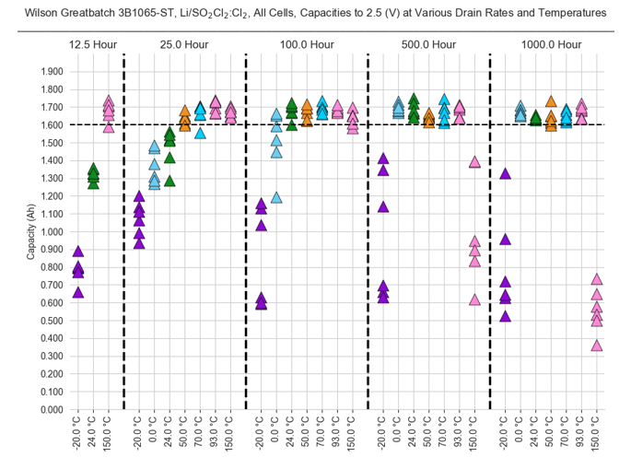
Data visualization – All Cells Capacity

Slide 11
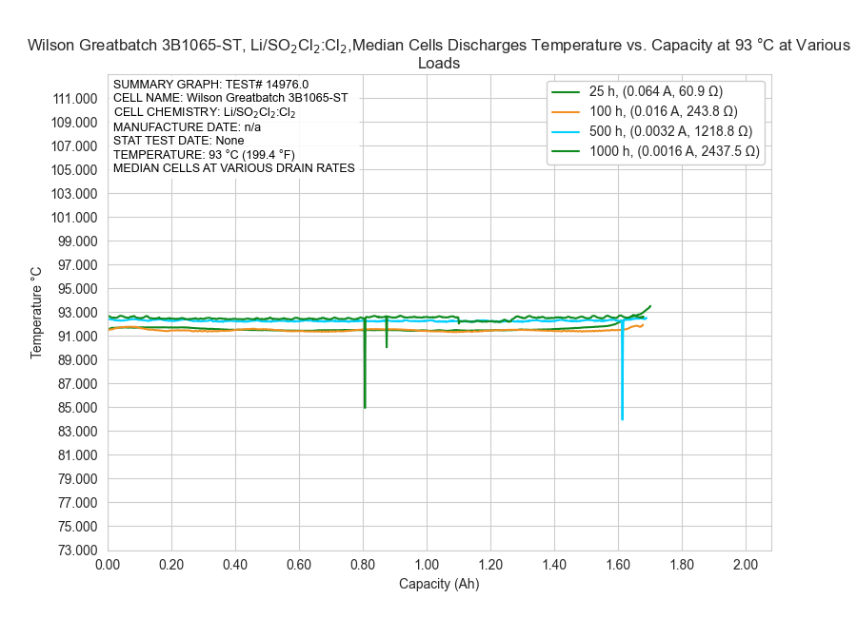
Data visualization – TvC

Slide 12
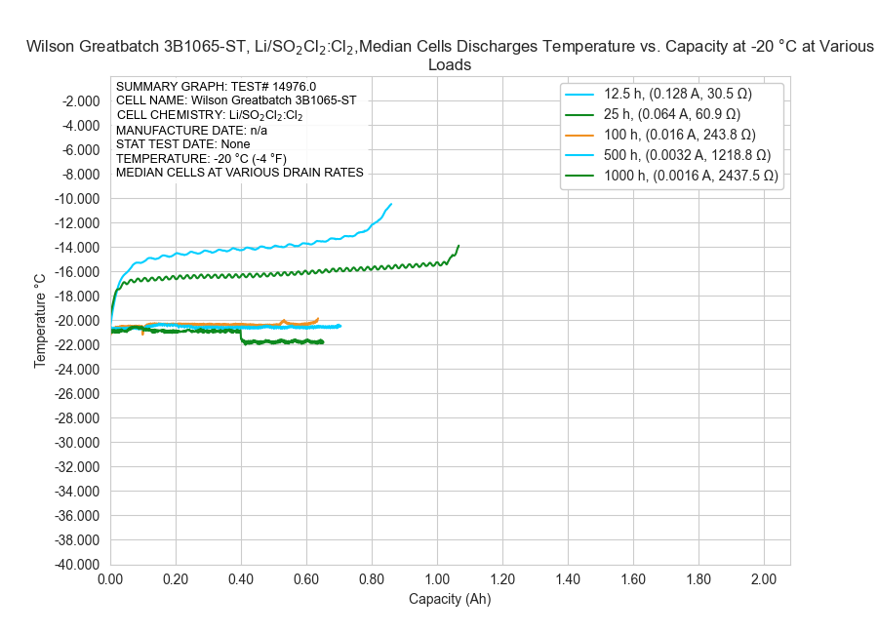
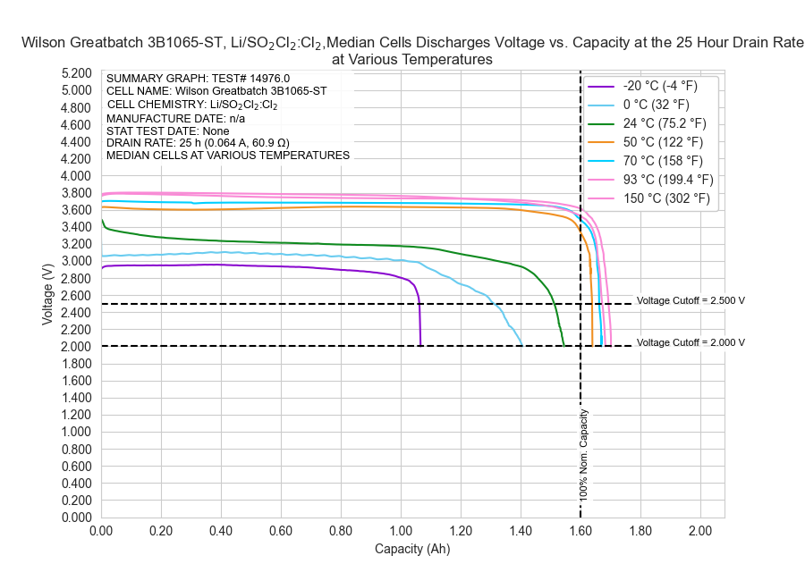
Data visualization – VvC
Grouped by temperature
Grouped by drain rate

Slide 13
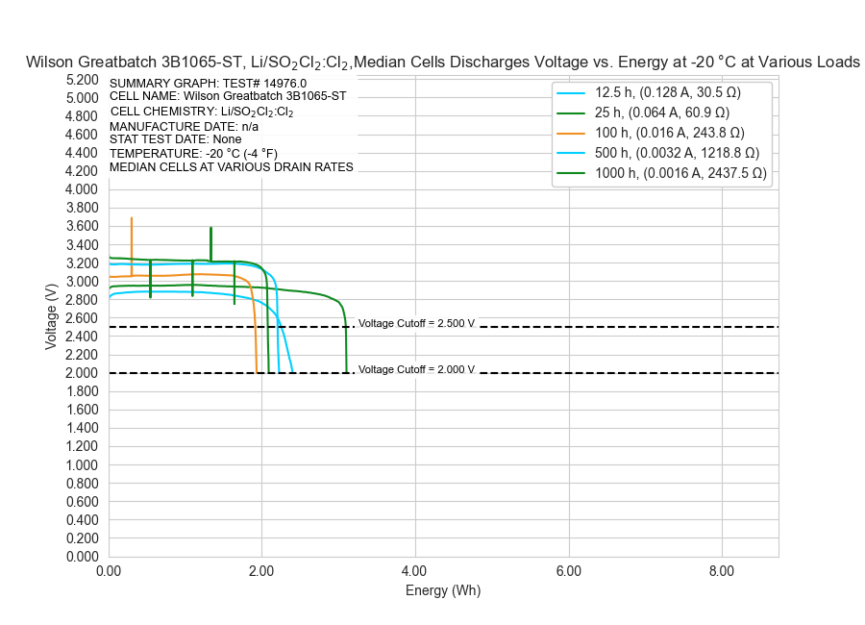
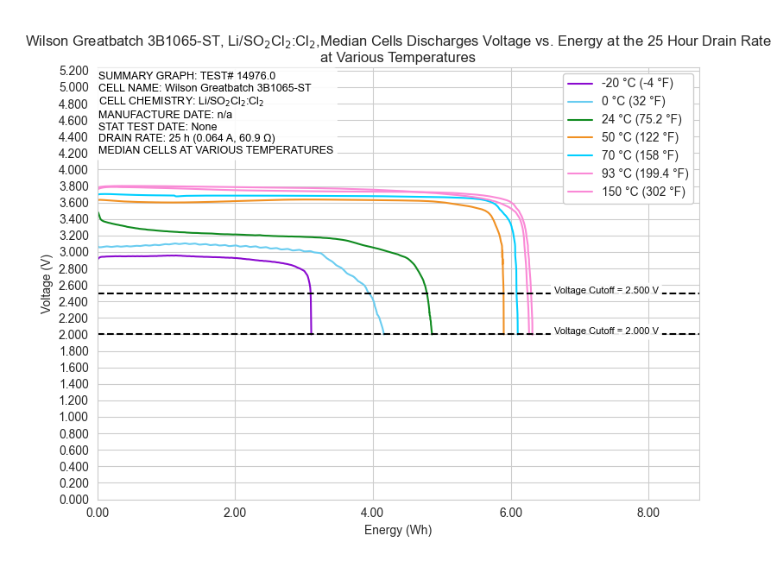
Data visualization – VvE
Grouped by temperature
Grouped by drain rate

Slide 14
Tables
Tests metrics
Test voltages
Weight and dimensions
Voltage drops
DCIR

Slide 15
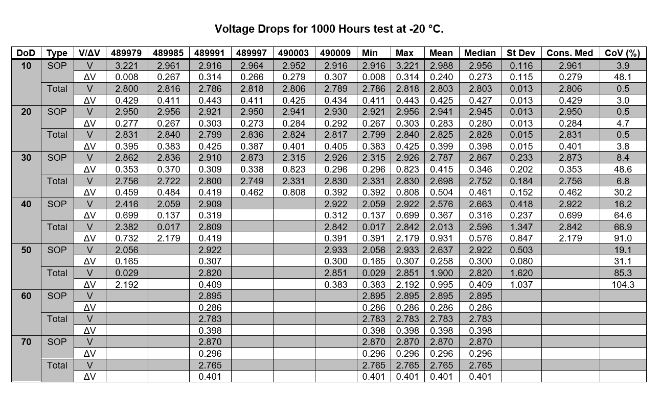
Voltage Drops

Slide 16
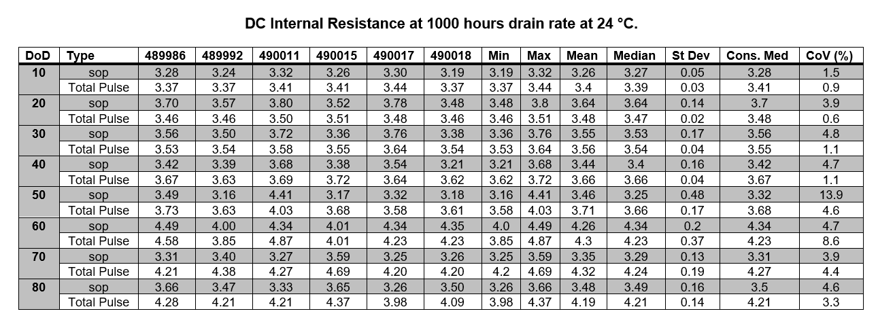
DCIR Table

Slide 17
Consolidated Report Notes
Most of the process is now automated using python
Still involves test engineers to ensure data is correct and to further data analysis
The process for building a consolidated report is the same as building a presentation and a html primary handbook entry

Slide 18
Next Steps
Start delivering consolidated reports
Continue to improve Primary Data Analysis Software
Start working on transitioning to Secondary consolidated reports

Slide 19
Conclusion
Building a consolidated report is a detailed and involved process for test engineers
Consolidated reports require multiple steps and systems
Data validation and reviews involve several test engineers
Consolidated reports summarize the complete test
Most plots include only the media cell
The process is automated using Python

